Slide 1
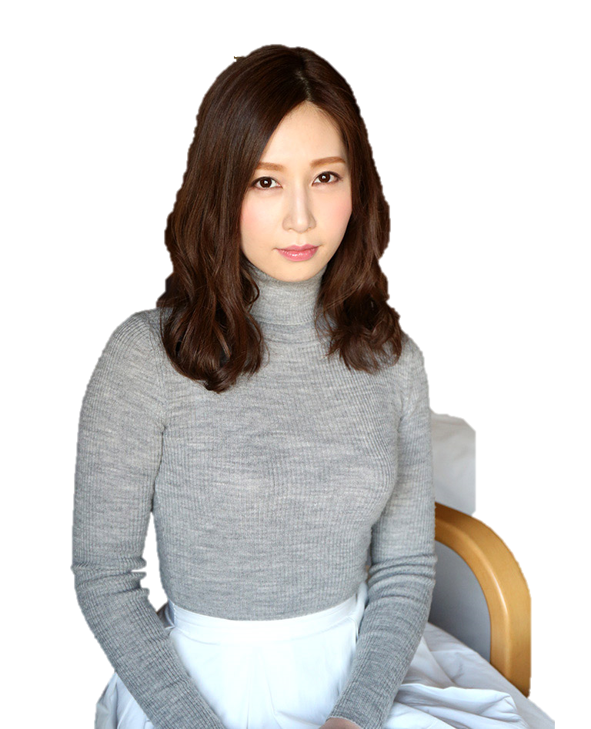
D:\Code\TeenAdvanced\Xactor_FACE_Recognition\Code chua chinh\file làm lại\consula\images\

Slide 2
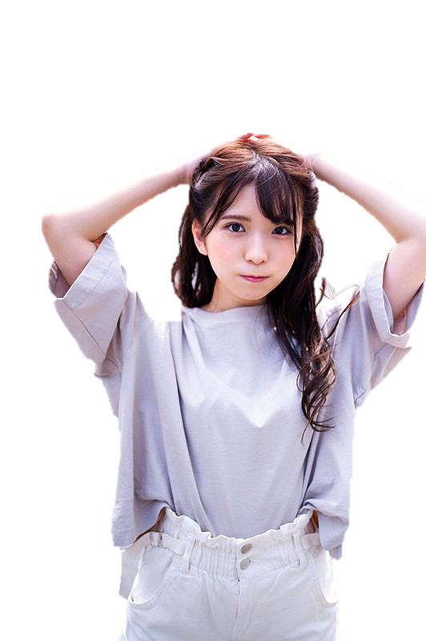
D:\Code\TeenAdvanced\Xactor_FACE_Recognition\Code chua chinh\file làm lại\consula\images\
Born : ???
Name : ???
Height : ???
Breast : ???
Hips : ???
Waist : ???

